Slide 1
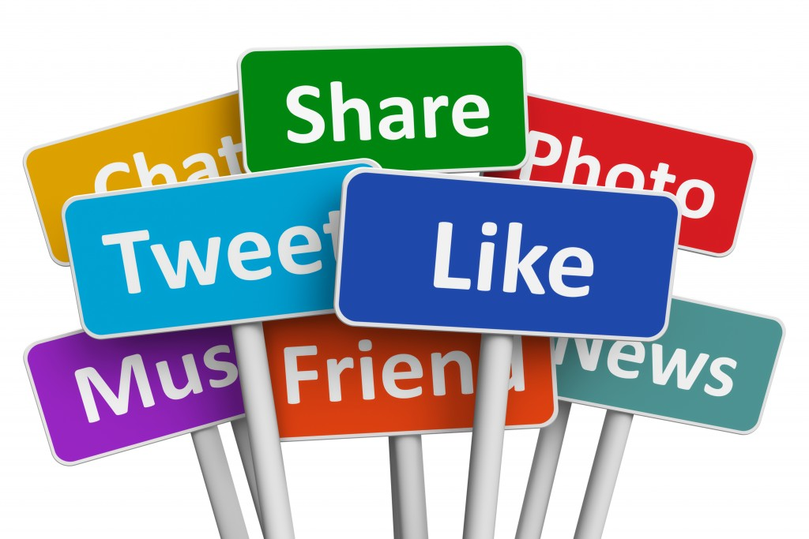
Social Media Analysis
by Neelam Rajput
This Photo by Unknown Author is licensed under CC BY-NC

Slide 2
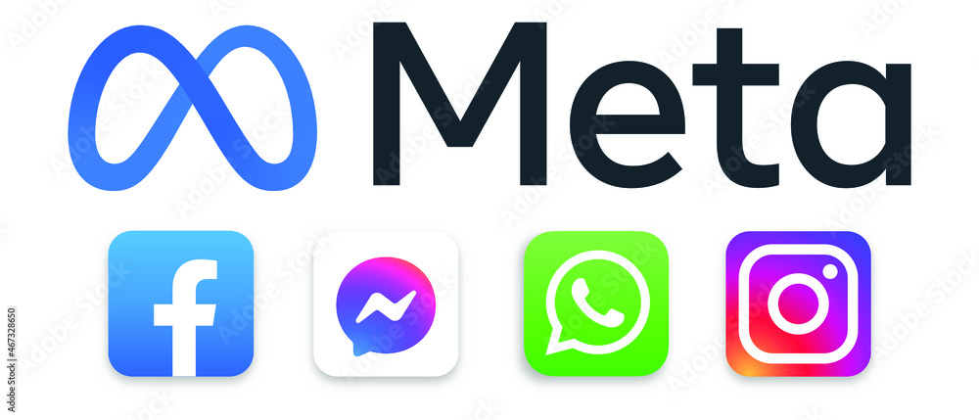
ABOUT META
Meta is a leading technology company focused on building innovative digital experiences that connect people, communities, and businesses globally. Its ecosystem—including Facebook, Instagram, WhatsApp, and Reality Labs—empowers billions to share, create, and explore immersive digital worlds.

Slide 3
AGENDA
Problem Statement
Data Description
Key Metrics and Visualizations
User Segmentation
Targeted Marketing Strategies & Recommendations

Slide 4
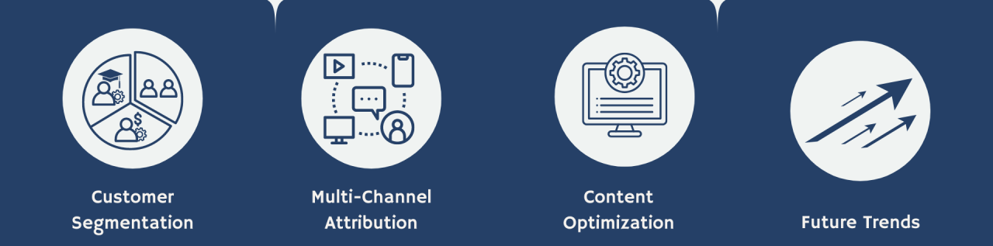
Problem Statement
You are hired as a data analyst at Meta and asked to collaborate with Marketing team. Marketing teams wants to leverage Instagram's user data to develop targeted marketing strategies that will increase user engagement, retention, and acquisition. Provide insights and recommendations to address the following objectives.

Slide 5
Data Description
The dataset contains information 7 tables. Below is an overview of the dataset:
Users Table : information about users registered on the platform
Photos Table: information about the photos uploaded by users.
Comments Table: Stores all comments made by users on photos.
Likes Table: Tracks which users liked which photos.
Follows Table: Tracks user relationships (followers and followees ).
Tags Table: Stores unique tags that are associated with photos.
Photo_Tags Table: connects photos with tags.
comments_id : unique identifier for each comment
comment_text : text content of a given comment
user_id : unique identifier for each user
photo_id : unique identifier for each photo
created_at : date of interaction in the form like, photos, tags
follower_id : user_id of the follower for a certain user
followee_id : user_id of followee for a certain user
tag_id : unique identifier for each tag
image_url : link to the image posted on the platform
username : username chosen by the user

Slide 6
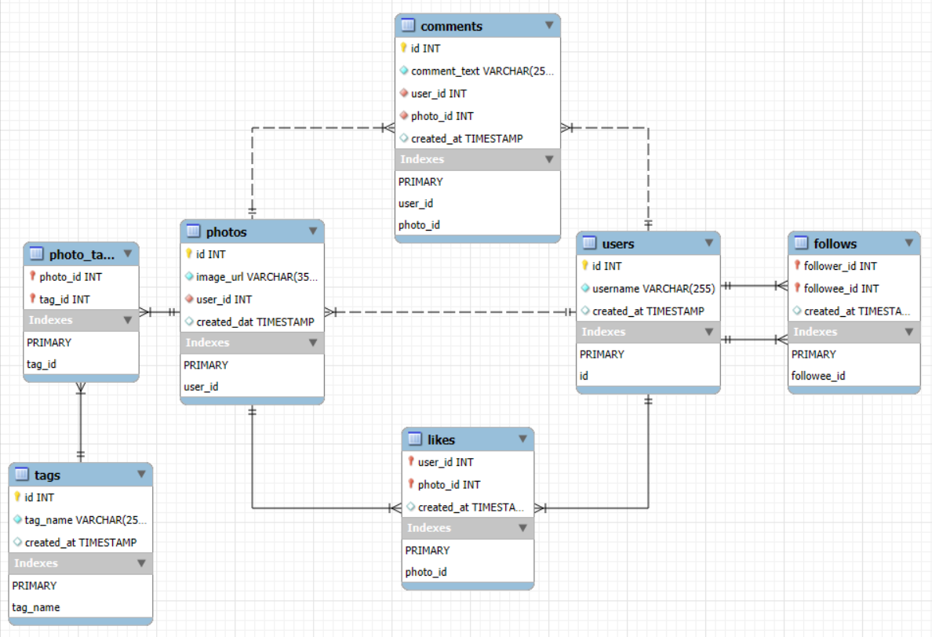
Database Schema

Slide 7
INSTAGRAM PROJECT OVERVIEW
Help Instagram marketing team develop strategies to increase
User Engagement
User Retention
User acquisition
Tools Used: MySQL Workbench, MS-Office, IG_Clone DB

Slide 8
DATA OVERVIEW
Total Users : 100
Total Likes : 8782
Total Comments : 7488
Total Photos : 257
Total Tags : 21
Total Photos * Tagged : 501

Slide 9
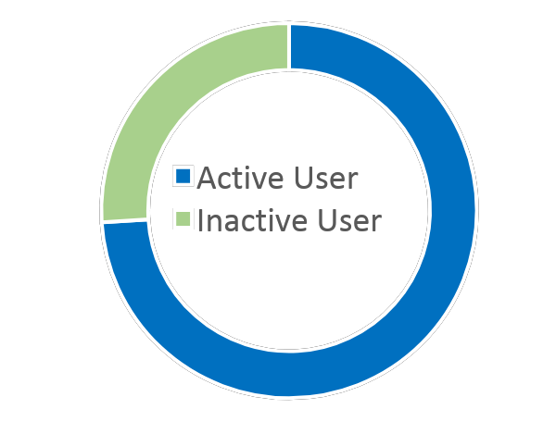
Users Distribution
Activity wise Inactive Users: 26 Active Users :74
About 74 % of users are only active over platform.
Those 26% users highlight a potential retention issue.
Try to engage them with interactive game challenges or rewards.

Slide 10
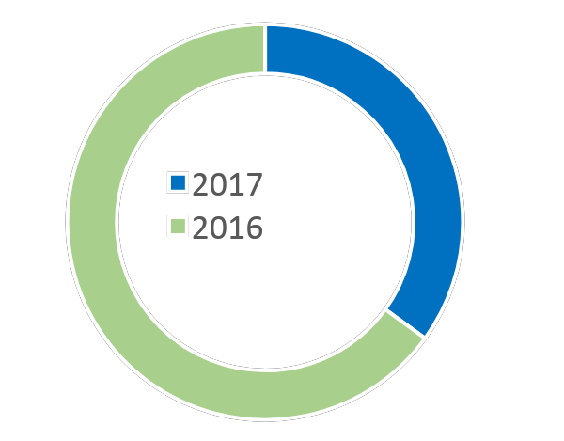


Users Distribution
Joining Year wise 35 USER JOINED IN 2017 65 USER JOINED IN 2016
The drop in the user joining in 2017, the priority should be on boosting user acquisition.
More advertisement should be done to get more users .
Add more engaging activity challenges to attract more users.

Slide 11
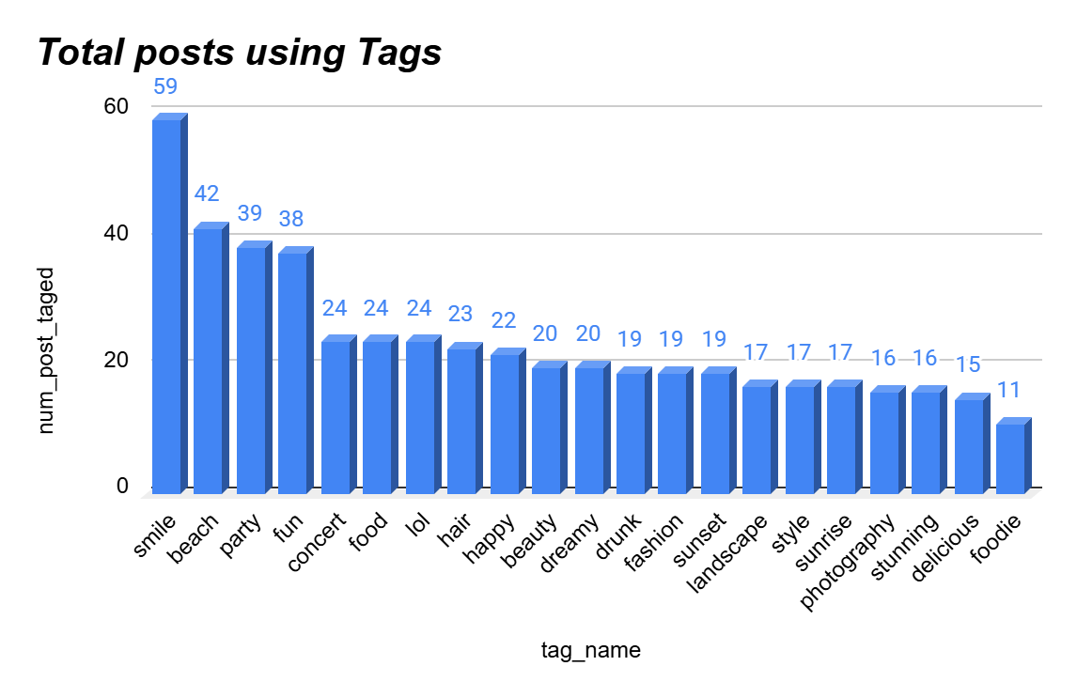
Tags Distribution
Maximum number of posts are done with tag “ Fun”,” Party”,“ Smile” and “Beach”.
Posts got less number of engagement done with tag related to food and photography.
Content creators can be guided to create more engaging content using these hashtag.

Slide 12
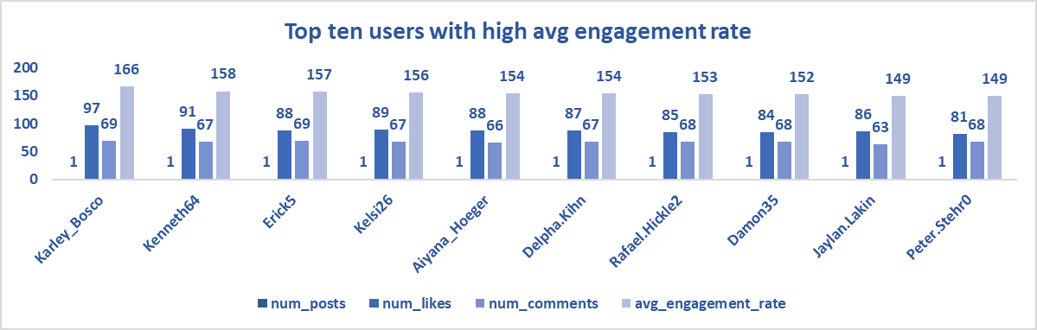
Top Users
Top users get massive engagement with single post.
For an ad campaign, targeting ten users like these is often more effective than targeting one celebrity.
With an average engagement rate peak of 166, Karley_Bosco represents an 'Ideal Content' benchmark.

Slide 13
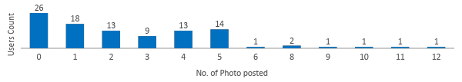
Post distribution
The largest group of users (26 users) has posted 0 photos.
Launching hashtag challenges and engagement games can effectively bridge the gap for users with lower post frequencies.
Active Users can use popular hashtags for better engagement.

Slide 14
User Acquisition
Tag Education Campaigns
Launch initiatives to educate users on the benefits of tags through blog posts and video tutorials
Referral Incentives
Launch a referral program rewarding users with discounts or exclusive content for bringing in new members.
Engagement Boosters
Send personalized emails highlighting new features, trending content, and tutorials to boost engagement
Tailor Onboarding Experience
Design a tailored onboarding for new users that highlights features, popular tags, and success stories.

Slide 15
User Retention
Re-Engagement Campaigns
Suggest targeted posts, hashtags, and users to follow based on past engagement, encouraging reconnection with the platform.
Exclusive Incentives
Offer limited-time discounts on premium features to encourage users to return to the platform
Content Discovery Aids
Create brief tutorials highlighting new features and trends to help users navigate the platform after a break.
Feedbacks and Surveys
Send brief surveys to inactive users to understand their disengagement, offering incentives for insights to inform retention strategies.

Slide 16
User Engagement
Educational Resources
Offer tutorials and webinars on maximizing engagement and using platform features effectively
Community Initiatives
Create forums and social events, and launch an ambassador program to promote the platform.
Influencer Collaborations
Partner with engaged influencers to attract new users and enhance current user participation
User Recognition
Introduce awards like ‘User of the Month’ and hold photo contests to boost engagement

Slide 17

Conclusion
User Acquisition Efforts: Leverage influencer partnerships and ambassador programs to attract new users, while implementing educational initiatives to help them effectively engage with the platform.
User Retention Strategies: Use personalized content recommendations, exclusive offers, and feedback mechanisms to retain users and address inactivity.
User Engagement Initiatives: Focus on re-engagement campaigns, tag usage promotions, and community-building activities to encourage inactive and moderately active users to enhance their overall experience.

Slide 18


